Slide 1
MJJA 2022 Climate Outlook
Summary for Policy Makers

Slide 2
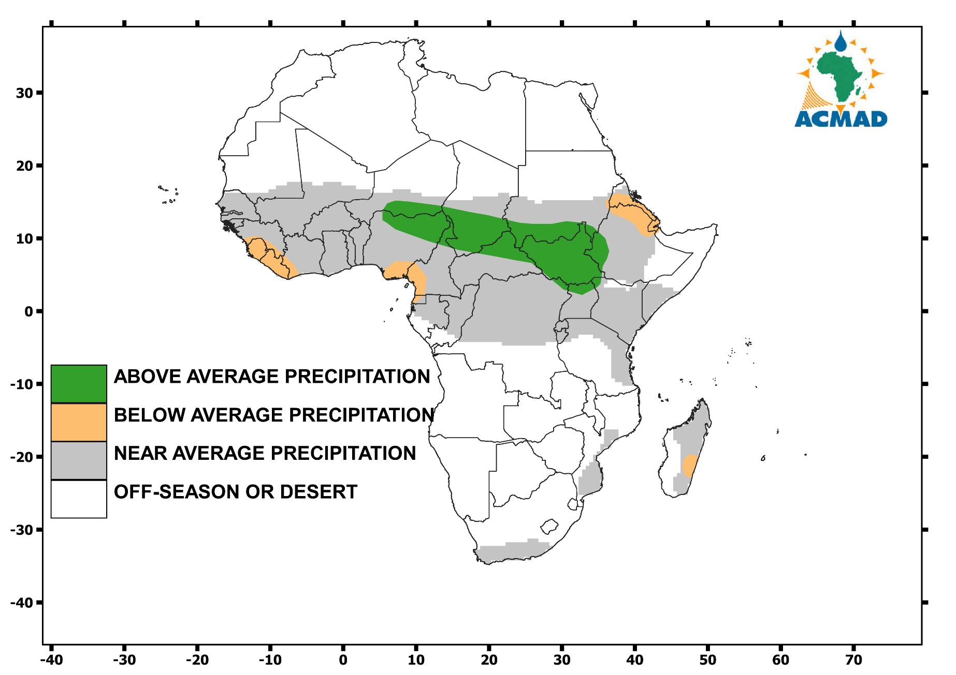
Seasonal CLIMATE outlook for MJJA 2022
MJJA 2022 Climate Outlook
Above average, near average and below average, off season or desert

Slide 3
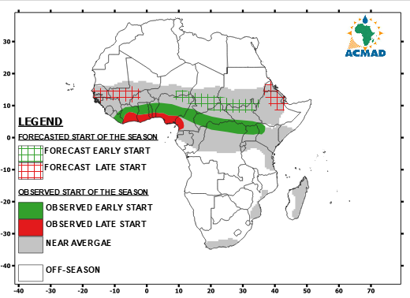
Onset of the RAINFALL season

Slide 4
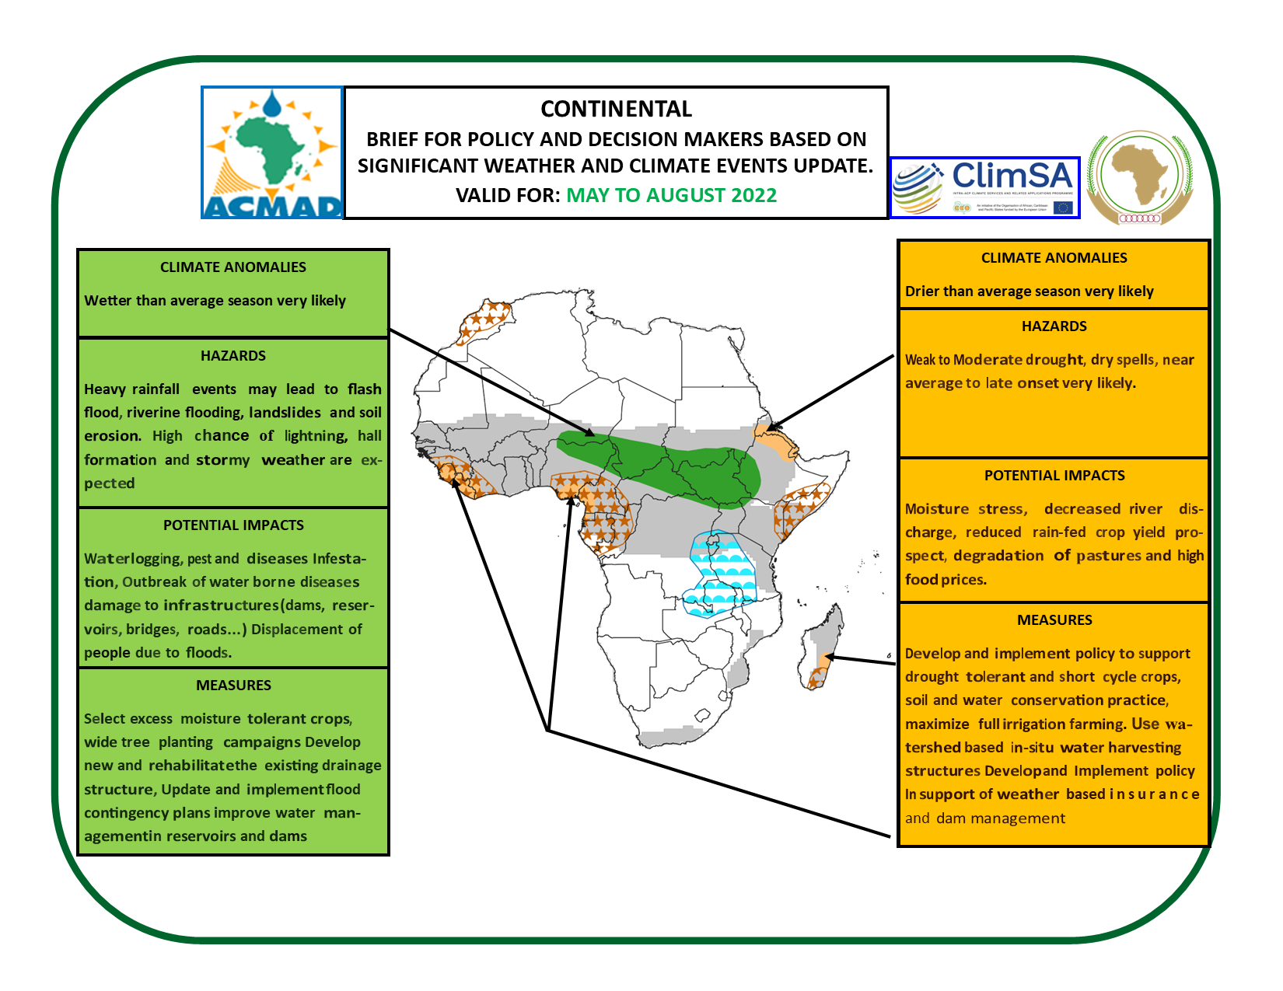
MJJA 2022 Climate Outlook – Policy Map
Policy BRIEF FOR MJJA 2022

Slide 5
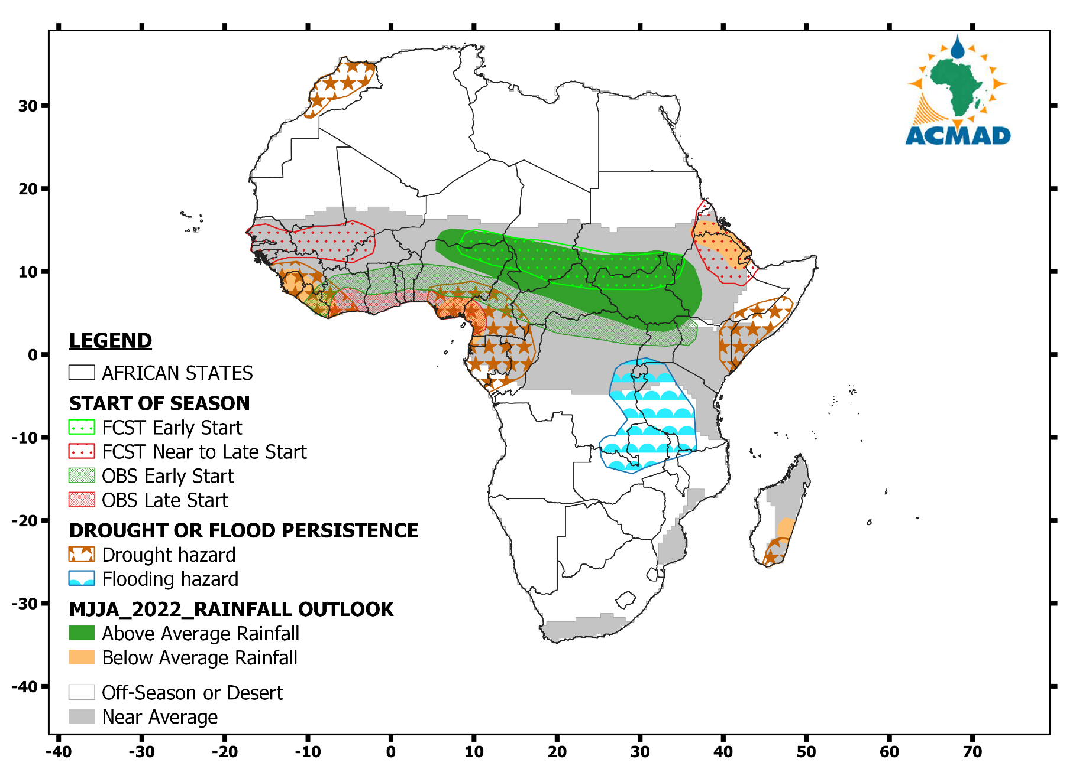
Drought and Flood Vigilance

Slide 6
This work is supported by the ClimSA project as part of the implementation of WMO’s Global Framework for Climate Services (GFCS)

